Slide 1
M-GEAR: Gateway-Based Energy-Aware Multi-Hop Routing Protocol
Qaisar Nadeem
Department of Electrical Engineering
Comsats Institute of Information Technology, Islamabad.
Sep 07, 2013

Slide 2
Outline
Introduction
Motivation
M-GEAR: Gateway-Based Energy-Aware Multi-Hop Routing Protocol
    Initial Phase
    Setup Phase
    Cluster Head Selection
    Scheduling
    Steady State Phase
Simulation Settings
Simulation Results
Conclusion

Slide 3
Introduction
Wireless Sensor Networks (WSNs) consist of wireless
sensors to monitor physical or environmental conditions
Sensor nodes compute, transmit, receive and forward data to Base Station
Sensors are limited in computations, energy, buffer size and
signal strength
WSNs applied to industrial, commercial, defense and civil
Applications
Few applications of WSNs are area monitoring, air quality
monitoring, natural disaster prevention and smart home
monitoring

Slide 4
Motivation
WSNs are highly affected by the energy dissipation of the
nodes
Impossible or unprofitable to replace batteries of nodes
Energy capacity of batteries in WSN is limited
A primary goal in WSNs routing is lifetime maximization
Clustering based protocols have gained great acceptance in
many applications
In cluster based routing protocols, Cluster Heads (CHs) are
elected based on a probability
CHs are not distributed uniformly in the sensor field
Nodes faraway from CH deplete energy fast

Slide 5
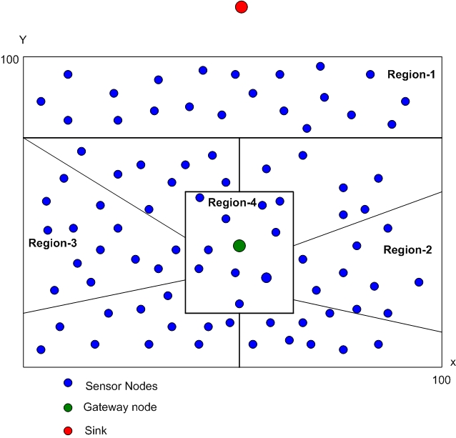
Network Settings
100 sensor nodes are randomly deployed in 100m x 100m field
Base Station is installed out of sensor field
A gateway node is used
for energy efficient routing
Sensor field is divided into
four logical regions

Slide 6
M-GEAR: Gateway-Based Energy-Aware Multi-Hop Routing Protocol
Initial Phase
Setup Phase
Cluster Head Selection
Scheduling

Slide 7
Initial Phase
Sink broadcasts a HELLO packet
Sensor nodes transmit acknowledge packet
Sink stores all information of nodes in Node Data Table
Node Data Table includes node ID, Residual Energy, and
distance of node from Sink and Gateway node

Slide 8
Setup Phase
Sink divides the nodes into four logical regions
Two regions use direct communication
Two regions use Clustering technique

Slide 9

Cluster Head Selection
CHs are elected based on the remaining energy of node and
probability p
Each node elects itself as a CH once every 1/p rounds
A node generates a random number between [0-1]
If the generated random number is less than a predefined threshold T(s) value, then the node becomes CH
(1)
where,
p = Desired percentage of CHs
r = Current round
C = Set of nodes not elected as CH in current round.

Slide 10
Scheduling
Each CH creates a TDMA based schedule for its member
nodes
CH aggregates data and forwards to Gateway node
Gateway node assigns a TDMA schedule to CH
Gateway aggregates data and forwards to Sink

Slide 11
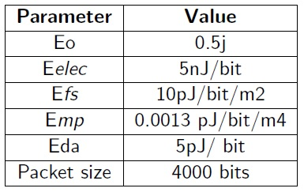
Simulation Settings
100 nodes are dispersed in 100m x 100m field
Gateway node is installed at centre of the field, however,
deployment of Base Station is out-of-field

Slide 12
Simulation Results

Slide 13
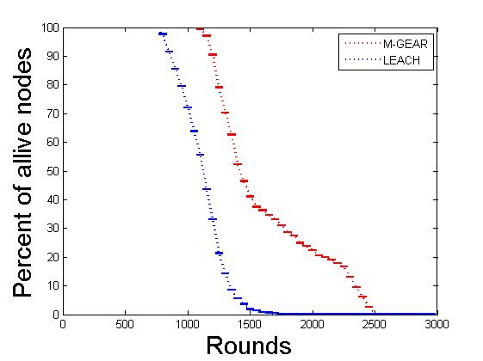
Network Lifetime
Use of gateway node minimizes the energy consumption of communication nodes
Uniform distribution of CHs occur due to logical division of network
Achieving of longer network lifetime than LEACH protocol

Slide 14
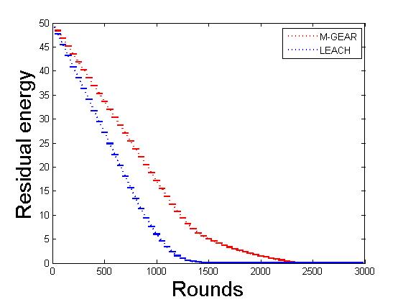
Residual Energy
Minimum energy consumption per round
Logical division of network balances energy consumption among nodes
Protocol ensures presence of CH in each region

Slide 15
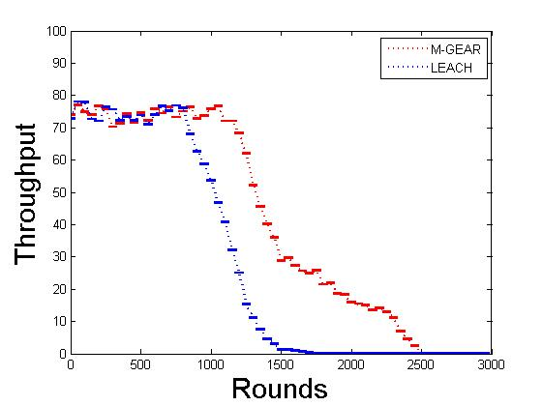
Throughput
Minimum energy consumption contributes towards longer network lifetime
More alive nodes encourage higher throughput of network

Slide 16
Conclusion
Multi-hop gateway-based energy efficient routing protocol for
WSNs
Gateway node is used to enhance the communication time of
sensor nodes
Sensor field is divided into four logical regions for effective
communication between nodes
Nodes in closer vicinity of sink node and gateway node use
direct transmission
Other two regions use clustering topology
CHs are selected on the basis of residual energy and a
probability p

Slide 17
Questions
Thank you!

