Slide 1
“LPCH and UDLPCH: Location-aware
Routing Techniques in WSNs”.
Y. Khan, N. Javaid, M. J. Khan, Y. Ahmad, M. H. Zubair, S. A. Shah

Slide 2
Outline
Abstract
Introduction
Related Work
Motivation
LPCH
UDLPCH
Simulation Results

Slide 3
Abstract
Need → energy efficient routing protocols.
We propose, LPCH and UDLPCH, routing schemes for WSNs.
We improve the energy efficiency of existing routing protocol; LEACH.
Simulation results show that LPCH is more efficient than LEACH, and UDLPCH is more efficient than LPCH.

Slide 4
Introduction and Related Work
WSN is composed of sensors, deployed inside the area of interest or very close to it.
Sensors send the sensed data to sink.
Sensors are limited in terms of energy capacity.
Routing protocols are needed to prolong the network lifetime.

Slide 5
Cont…
In DC, sensors directly send data to sink.
In MTE, sensors transmit data to sink through intermediate hops based on distance.
LEACH; clustering protocol.
  CHs are selected randomly.
  Nodes send data to CH which forwards the data to sink.

Slide 6
Cont…
E-LEACH; all nodes have same probability for the selection of CHs (in first round), in next rounds CHs are selected on the basis of residual energy of nodes.
M-LEACH selects optional path between CHs and sink through other CHs.
Partition-LEACH improves performance of the network by dividing area into subareas.

Slide 7
Motivation
In LEACH, CHs are selected randomly.
  So, the clusters are different in terms of size.
  LEACH does not guarantee optimum number of CHs in each round.
  CH, resposible to forward the data of greater number of nodes, consumes large energy in collecting data from member nodes.

Slide 8
Network Model
Network field is divided into two regions.
Equal number of nodes→deployed in each region.
Each node has fixed position and unique ID.
Our proposed network model uses first order radio model.

Slide 9
LPCH
First round: CHs are selected by LEACH algorithm.
From second round: CHs, same in number to round one, are selected.
Number of CHs in each region are same throughout the network lifetime.

Slide 10
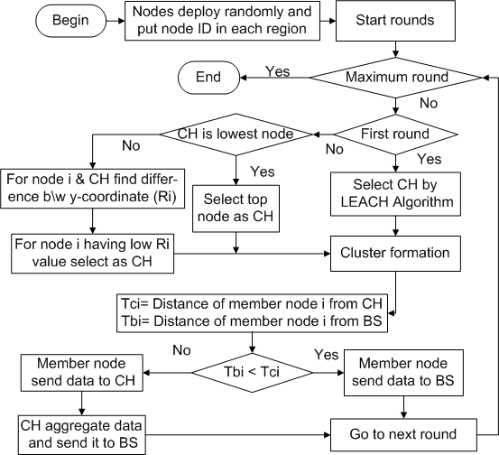
Cont…
(LPCH: flow chart)

Slide 11
UDLPCH
UDLPCH improves the energy efficiency of LPCH algorithm.
  In first round, user selects equal number of CHs in each region.
  From second round, CHs’ selection is according to LPCH algorithm.

Slide 12
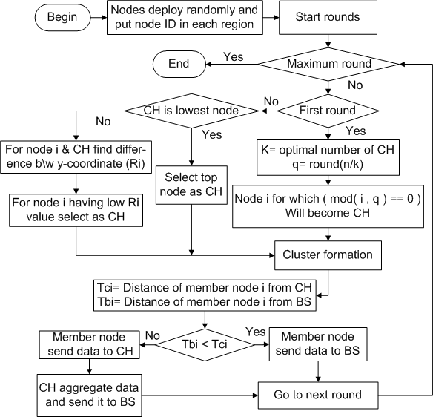
Cont…
(UDLPCH: flow chart)

Slide 13
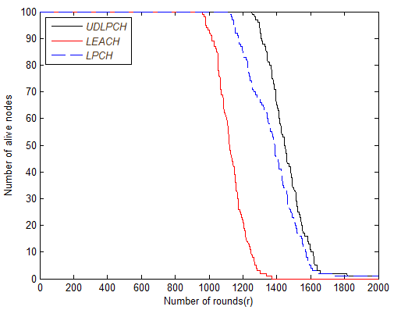
Simulation Results
Stability period of LPCH is 10% greater than LEACH, whereas, that of UDLPCH is 8% greater than LPCH.
  LEACH does not guarantee the required number of CHs.
  LPCH; network field is divided into two regions and the number of CHs selected in first round of each region are maintained till the end of the network lifetime.
  UDLPCH; user defined CHs in each region.
(Comparison: alive nods)

Slide 14
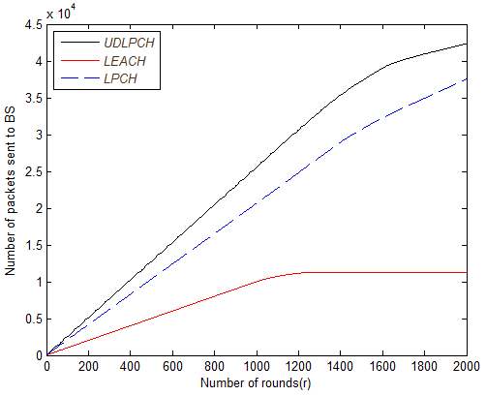
Cont...
Throughput of LPCH is 350% more than LEACH, whereas, that of UDLPCH is 12.5% more than LPCH.
  LEACH; zero CHs selected→node directly sends packet to sink.
  LPCH; distance (node to CH) > distance (node to sink)→packet is directly sent to BS.
  UDLPCH; extended network lifetime increases the throughput.
(Comparison: throughput)

