Slide 1
An Application-Specific Protocol Architecture for Wireless Micro sensor Networks
LEACH-C

Slide 2
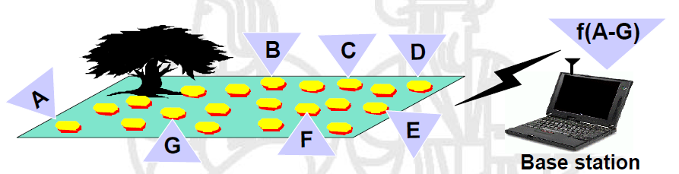
Microsensor Networks

Slide 3
Abstract
micro sensor nodes
  accurately monitor a remote environment by intelligently combining the data from the individual nodes.
  require robust wireless communication protocols that are
    energy efficient and provide low latency.
In this paper, we develop and analyze
  LEACH
    includes a distributed cluster formation technique that enables
      self-organization of large numbers of nodes,
      algorithms for adapting clusters
      rotating cluster head positions,
      techniques to enable distributed signal processing to save communication resources.
  a protocol architecture for micro sensor networks that combines the ideas of
    energy-efficient cluster-based routing
    media access together with application-specific data aggregation to achieve good performance in terms of system lifetime, latency, and application-perceived quality.
Our results show that
  LEACH can improve system lifetime by an order of magnitude compared with general-purpose multihop approaches.

Slide 4
I. INTRODUCTION
Micro sensors,
  low-power sensors
  low-power electronics
  low-power RF design
  small, relatively inexpensive
wireless micro sensor networks
  enable the reliable monitoring of a variety of environments for applications that include
    surveillance,
    machine failure diagnosis,
    and chemical/biological detection.
An important challenge in the design of micro sensor networks is that two key resources
  communication bandwidth and energy efficiency.
    are significantly more limited than in a tethered network environment.

Slide 5
I. INTRODUCTION
to design good protocols for wireless micro sensor networks
  important to understand the parameters that are relevant to the sensor applications
    we use the following metrics.
      Ease of Deployment
      System Lifetime (Energy efficiency)
      Latency
      Quality

Slide 6
I. INTRODUCTION
A. Ease of Deployment
  need to be deployed in remote or dangerous environments,
  allowing users to extract information in ways that would not have been possible otherwise.
  This requires that
    nodes be able to communicate with each other even in the absence of an established network infrastructure and predefined node locations.
B. System Lifetime (Energy efficiency)
  networks should function for as long as possible.
    inconvenient or impossible to recharge node batteries.
  Therefore, all aspects of the node, from the hardware to the protocols, must be designed to be extremely energy efficient.
C. Latency
  Data from sensor networks are typically time sensitive,
    important to receive the data in a timely manner.

Slide 7
I. INTRODUCTION
D. Quality
  “quality” in a micro sensor network is very different than in traditional wireless data networks.
  For sensor networks,
    the end user does not require all the data in the network because
      1) the data from neighboring nodes are highly correlated, making the data redundant and
      2) the end user cares about a higher-level description of events occurring in the environment being monitored.
    The quality of the network is, therefore, based on the quality of the aggregate data set,
      so protocols should be designed to optimize for the unique, application- specific quality of a sensor network.

Slide 8
I. INTRODUCTION
This paper builds on the work described in [11] by giving a detailed description and analysis of LEACH, an application-specific protocol architecture for wireless micro sensor networks.
LEACH employs the following techniques to achieve the design goals stated:
  1) randomized, adaptive, self-configuring cluster formation;
  2) localized control for data transfers;
  3) low-energy MAC
  4) application-specific data processing, such as data aggregation or compression.
Simulation results show that
  LEACH is able to achieve the desired properties of sensor networks.

Slide 9
II. BACKGROUND
Since both device and battery technology have only recently matured to the point where microsensor nodes are feasible.
There have been some application-specific protocols developed for microsensor networks.
  Clare et al. developed a (TDMA)MAC protocol for low-energy operation [5].
    Using a TDMA approach saves energy by allowing the nodes to remain in the sleep state, with radios powered-down, for a long time.
  Intanagonwiwat et al. developed directed diffusion, a protocol that employs
    a data-driven model to achieve low-energy routing [13].
Recently, there has been much work on “power-aware” routing protocols for wireless networks [19], [25].
  In these protocols, optimal routes are chosen based on the energy at each node along the route.
  Routes that are longer, but which use nodes with more energy than the nodes along the shorter routes, are favored, helping avoid “hot spots” in the network.

Slide 10

II. BACKGROUND
In LEACH, we use randomized rotation of the cluster head positions to achieve the same goal.
One method of choosing routes is to use “minimum transmission energy” (MTE) routing [8], [24],
  where intermediate nodes are chosen such that the sum of squared distances (total transmit energy ETX(d) , assuming a d² power loss) is minimized.
  Thus, for three nodes A, B, and C, node A would transmit to node C through node B if and only if
  or .
  This approach ignores the energy dissipated in the radio to send and receive the data and, therefore, may not actually produce the lowest energy routes.
Another method of wireless communication is to use clustering.
  nodes send their data to a central cluster head that forwards the data to get it closer to the desired recipient.
  Clustering enables bandwidth reuse and can, thus, increase system capacity.
  Using clustering enables better resource allocation and helps improve power control [14].

Slide 11
II. BACKGROUND
While conventional cluster-based networks rely on a fixed infrastructure,
new research is focusing on ways to deploy clustering architectures in an ad-hoc fashion [3], [15], [23].
Early work by Baker et al. developed a linked cluster architecture, where nodes are assigned to be either ordinary nodes, cluster head nodes, or gateways between different clusters [3].
  The cluster heads act as local control centers, whereas the gateways act as the backbone network, transporting data between clusters.
  This enables robust networking with point-to-point connectivity.
Another ad-hoc clustering protocol, the near term digital radio (NTDR), uses a clustering approach with a two-tier hierarchical routing algorithm [23].
  Nodes form local clusters, and intra-cluster data are sent directly from one node to the next, whereas inter-cluster data are routed through the cluster head nodes.
  This protocol enables point-to-point connectivity and does not use low-energy routing or MAC; therefore, it is not suited for microsensor networks.
LEACH builds on this work by creating a new ad-hoc cluster formation algorithm that better suits microsensor network applications.

Slide 12
III. LEACH PROTOCOL ARCHITECTURE…
To meet the unique requirements of wireless microsensor networks, we developed LEACH, an application-specific protocol architecture [10], [11].
The application that typical microsensor networks support is the
  monitoring of a remote environment.
Since individual nodes’ data are often correlated * in a microsensor network,
  the end user does not require all the (redundant) data; rather, the end user needs a high-level function of the data that describes the events occurring in the environment.
Because the correlation is strongest between data signals from nodes located close to each other,
  we chose to use a clustering infrastructure as the basis for LEACH.
This allows all data from nodes within the cluster to be processed locally, reducing the data set that needs to be transmitted to the end user.
In particular, data aggregation techniques can be used to combine several correlated data signals into a smaller set of information that maintains the effective data (i.e., the information content) of the original signals [9]. Therefore, much less actual data needs to be transmitted from the cluster to the base station (BS).
Notes:
Correlation* is a statistical measurement of the relationship between two variables. Possible correlations range from +1 to –1. A zero correlation indicates that there is no relationship between the variables. A correlation of –1 indicates a perfect negative correlation, meaning that as one variable goes up, the other goes down. A correlation of +1 indicates a perfect positive correlation, meaning that both variables move in the same direction together.

Slide 13
III. LEACH PROTOCOL ARCHITECTURE
For the development of LEACH, we made some assumptions about the sensor nodes and the underlying network model.
For the sensor nodes, we assume that
  all nodes can transmit with enough power to reach the BS if needed, that the nodes can use power control to vary the amount of transmit power, and that each node has the computational power to support different MAC protocols and perform signal processing functions.
  These assumptions are reasonable due to technological advances in radio hardware and low-power computing.
For the network, we use a model where nodes always have data to send to the end user and nodes located close to each other have correlated data.
In Section V, we discuss ways in which LEACH may be improved when these assumptions do not hold.

Slide 14
III. LEACH PROTOCOL ARCHITECTURE
In LEACH, the nodes organize themselves into local clusters, with one node acting as the cluster head.
All non-cluster head nodes transmit their data to the cluster head, while the cluster head node receives data from all the cluster members, performs signal processing functions on the data (e.g., data aggregation), and transmits data to the remote BS.
  Therefore, being a cluster head node is much more energy intensive than being a noncluster head node.
If the cluster heads were chosen a priori and fixed throughout the system lifetime, these nodes would quickly use up their limited energy.
  Once the cluster head runs out of energy, it is no longer operational, and all the nodes that belong to the cluster lose communication ability. Thus, LEACH incorporates randomized rotation of the high-energy cluster head position among the sensors to avoid draining the battery of any one sensor in the network.
  In this way, the energy load of being a cluster head is evenly distributed among the nodes.

Slide 15

III. LEACH PROTOCOL ARCHITECTURE
The operation of LEACH is divided into rounds.
  Each round begins with a set-up phase when the clusters are organized, followed by a steady-state phase when data are transferred from the nodes to the cluster head and on to the BS, as shown in Fig. 1.
Fig. 1. Time line showing LEACH operation. Adaptive clusters are formed
during the set-up phase and data transfers occur during the steady-state phase.

Slide 16
III. LEACH PROTOCOL ARCHITECTURE
describe
  A. Cluster Head Selection Algorithms
  B. distributed Cluster Formation Algorithm
  C. Steady-State Phase
  D. LEACH-C: BS Cluster Formation

Slide 17
  A. Cluster Head Selection Algorithms in LEACH
LEACH forms clusters by using a distributed algorithm,
  where nodes make autonomous decisions without any centralized control.
Our goal is to design a cluster formation algorithm such that
  there are a certain number of clusters, k , during each round.
In addition, if nodes begin with equal energy, our goal is to
  evenly distribute the energy load among all the nodes in the network so that there are no overly-utilized nodes that will run out of energy before the others.
As being a cluster head node is much more energy intensive than being a non-cluster head node, this requires that
  each node take its turn as cluster head.

Slide 18

A. Cluster Head Selection Algorithms in LEACH
Each sensor i elects itself to be a cluster head at the beginning of round r+1 (which starts at time ) with probability Pi(t).
Pi(t) is chosen such that the expected number of cluster head nodes for this round is k . Thus, if there are N nodes in the network
  Ensuring that all nodes are cluster heads the same number of times requires each node to be a cluster head once in N⁄k rounds on average.

Slide 19

A. Cluster Head Selection Algorithms in LEACH
If Ci(t) is the indicator function determining whether or not node has been a cluster head in the most recent (r mod(N⁄k)) rounds (i.e., Ci(t)=0 if node i has been a cluster head and one otherwise)
  then each node should choose to become a cluster head at round r with probability
only nodes that have not already been cluster heads recently, and which presumably have more energy available than nodes that have recently performed energy-intensive function, may become cluster heads at round r+1.

Slide 20

A. Cluster Head Selection Algorithms in LEACH
The expected number of nodes that have not been cluster heads in the first r rounds is N-k*r. After N⁄k rounds, all nodes are expected to have been cluster head once, following which they are all eligible to perform this task in the next sequence of rounds.
Since Ci(t) is one if node i is eligible to be a cluster head at time t and zero otherwise, the term represents the total number of nodes that are eligible to be a cluster head at time t and
  This ensures that the energy at all nodes are approximately equal to each other after every N⁄k rounds.

Slide 21
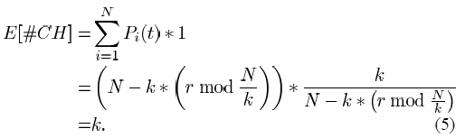
A. Cluster Head Selection Algorithms in LEACH
Using (3) and (4), the expected number of cluster heads per round is
This choice of probability for becoming a cluster head is based on the assumption that all nodes start with an equal amount of energy, and that all nodes have data to send during each frame.
If nodes have different amounts of energy (or an event-driven model is used, whereby nodes only send data when some event occurs in the environment), the nodes with more energy should be cluster heads more often than the nodes with less energy, to ensure that all nodes die at approximately the same time.
This can be achieved by setting the probability of becoming a cluster head as a function of a node’s energy level relative to the aggregate energy remaining in the network, rather than purely as a function of the number of times the node has been cluster head, Thus

Slide 22



A. Cluster Head Selection Algorithms in LEACH
where Ei(t) is the current energy of node i and
Using these probabilities, the nodes with higher energy are more likely to become cluster heads than nodes with less energy. The expected number of cluster head nodes is
Equation (6) can be approximated by (3) when the nodes begin with equal energy [10].

Slide 23
A. Cluster Head Selection Algorithms in LEACH
To use the probabilities in (6), each node must have an estimate of the total energy of all nodes in the network.
  This requires a routing protocol that allows each node to determine the total energy, whereas the probabilities in (3) enable each node to make completely autonomous decisions.
One approach to avoid this might be to approximate the aggregate node energy by multiplying the average energy of the nodes in each cluster by N.
Note that
  to compute the probabilities in (3) and (6) requires that each node knows the parameters k and N. In this paper, we assume these parameters are programmed into the nodes a priori. However, this approach does not work well in dynamic networks.

Slide 24
A. Cluster Head Selection Algorithms in LEACH
As we show in Section IV-B, the optimal number of clusters k is a function of the number of nodes N distributed throughout an M×M region of space.
Therefore, the nodes only need to determine N assuming there is a predefined specification for M. To do this, nodes can send “hello” messages to all neighbors within a predetermined number of hops (to approximate M). Each node can count the number of “hello” messages it receives—this is that node’s estimate for N. The desired number of clusters k can then be determined based on these parameters.
This approach allows LEACH to adapt to changing networks at the cost of increased overhead.

Slide 25
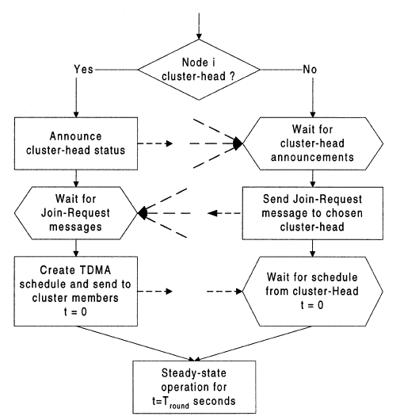
B. Cluster Formation Algorithm in LEACH
Fig. 2. Flowchart of the distributed
cluster formation algorithm for LEACH.

Slide 26
B. Cluster Formation Algorithm in LEACH
Once the nodes have elected themselves to be cluster heads using the probabilities in (3) or (6), the cluster head nodes must let all the other nodes in the network know that they have chosen this role for the current round.
To do this, each cluster head node broadcasts an advertisement message (ADV) using a nonpersistent CSMA MAC protocol [18].
  This message is a small message containing the node’s ID and a header that distinguishes this message as an announcement message.
Each non-cluster head node determines its cluster for this round by choosing the cluster head that requires the minimum communication energy, based on the received signal strength of the advertisement from each cluster head.
  Assuming symmetric propagation channels for pure signal strength, the cluster head advertisement heard with the largest signal strength is the cluster head that requires the minimum amount of transmit energy to communicate with.
Note that typically
  this will be the cluster head closest to the sensor, unless there is an obstacle impeding communication. In the case of ties, a random cluster head is chosen.

Slide 27
B. Cluster Formation Algorithm in LEACH
After each node has decided to which cluster it belongs, it must inform the cluster head node that it will be a member of the cluster.
  Each node transmits a join-request message (Join-REQ) back to the chosen cluster head using a nonpersistent CSMA MAC protocol.
  This message is again a short message, consisting of the node’s ID and the cluster head’s ID.

Slide 28
B. Cluster Formation Algorithm in LEACH
The cluster heads in LEACH act as local control centers to coordinate the data transmissions in their cluster.
  The cluster head node sets up a TDMA schedule and transmits this schedule to the nodes in the cluster.
This ensures that there are no collisions among data messages and also allows the radio components of each non-cluster head node to be turned off at all times except during their transmit time, thus reducing the energy consumed by the individual sensors.
  After the TDMA schedule is known by all nodes in the cluster, the set-up phase is complete and the steady-state operation (data transmission) can begin.

Slide 29
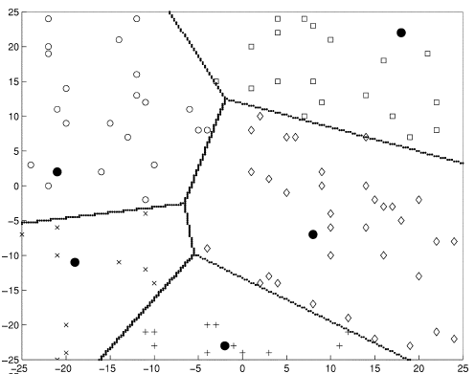
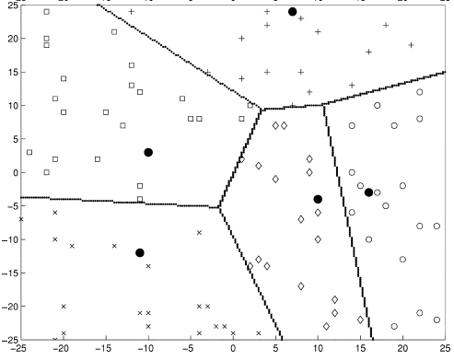
B. Cluster Formation Algorithm in LEACH
Fig. 3. Dynamic cluster formation during two different rounds of LEACH. All nodes marked with a given symbol belong to the same cluster, and the cluster head nodes are marked with .

Slide 30

C. Steady-State Phase in LEACH
The steady-state operation is
  broken into frames, where nodes send their data to the cluster head at most once per frame during their allocated transmission slot.
  The duration of each slot in which a node transmits data is constant, so the time to send a frame of data depends on the number of nodes in the cluster.
Fig. 4 shows the time line for one round of LEACH. We assume that the nodes are all time synchronized and start the set-up phase at the same time.
This could be achieved, for example, by having the BS send out synchronization pulses to the nodes.
Fig. 4. Time line showing LEACH operation. Data transmissions are explicitly
scheduled to avoid collisions and increase the amount of time each non-cluster
head node can remain in the sleep state.

Slide 31
C. Steady-State Phase in LEACH
To reduce energy dissipation,
  each non-cluster head node uses power control to set the amount of transmit power based on the received strength of the cluster head advertisement.
  Furthermore, the radio of each non-cluster head node is turned off until its allocated transmission time.
Since we optimize our design for the situation when all the nodes have data to send to the cluster head, using a TDMA schedule is an efficient use of bandwidth and represents a low-latency and energy-efficient approach.
The cluster head must be awake to receive all the data from the nodes in the cluster.
  Once the cluster head receives all the data, it performs data aggregation to enhance the common signal and reduce the uncorrelated noise among the signals. In our analysis, we assume perfect correlation such that all individual signals can be combined into a single representative signal.
  The resultant data are sent from the cluster head to the BS. Since the BS may be far away and the data messages are large, this is a high-energy transmission.

Slide 32
C. Steady-State Phase in LEACH
The preceding discussion describes communication within a cluster, where the MAC and routing protocols are designed to ensure low energy dissipation in the nodes and no collisions of data messages within a cluster. However, radio is inherently a broadcast medium.
  As such, transmission in one cluster will affect (and often degrade) communication in a nearby cluster.
To reduce inter-cluster interference, each cluster in LEACH communicates using direct-sequence spread spectrum (DSSS).
  Each cluster uses a unique spreading code; all the nodes in the cluster transmit their data to the cluster head using this spreading code and the cluster head filters all received energy using this spreading code. This is known as transmitter-based code assignment [12], since all transmitters within the cluster use the same code.
  The first cluster head to advertise its position is assigned the first code on a predefined list, the second cluster head to advertise its position is assigned the second code, and so on.
  With enough spreading, neighboring clusters’ radio signals will be filtered out as noise during decorrelation and not corrupt the transmission from nodes in the cluster. To reduce the possibility of interfering with nearby clusters and reduce its own energy dissipation, each node adjusts its transmit power.

Slide 33
C. Steady-State Phase in LEACH
Therefore, there will be few overlapping transmissions and little spreading of the data is actually needed to ensure a low probability of collision.
Data is sent from the cluster head nodes to the BS using a fixed spreading code and CSMA.
  When a cluster head has data to send (at the end of its frame), it must sense the channel to see if anyone else is transmitting using the BS spreading code.
  If so, the cluster head waits to transmit the data. Otherwise, the cluster head sends the data using the BS spreading code.
Other channelization techniques, such as having each cluster use a different frequency band (e.g., FDMA), are possible.
  However, since the number of clusters in LEACH is not fixed, using DSSS ensures that all nodes will receive better communication channels when there are fewer clusters. It is much harder to dynamically assign frequency bands so that all the bandwidth is utilized in a fixed channelization scheme.
  drawback of using DSSS is the
    need for tight timing synchronization, which may necessitate extra communication between the cluster head and the non-cluster head nodes.

Slide 34
D. LEACH-C: BS Cluster Formation
While there are advantages to using LEACHs distributed cluster formation algorithm,
  this protocol offers no guarantee about the placement and/or number of cluster head nodes.
Since the clusters are adaptive, obtaining a poor clustering set-up during a given round will not greatly affect overall performance.
  However, using a central control algorithm to form the clusters may produce better clusters by dispersing the cluster head nodes throughout the network.
This is the basis for LEACH-centralized (LEACH-C), a protocol that
  uses a centralized clustering algorithm and the same steady-state protocol as LEACH.

Slide 35
D. LEACH-C: BS Cluster Formation
During the set-up phase of LEACH-C,
  each node sends information about its current location (possibly determined using a GPS receiver) and energy level to the BS.
  In addition to determining good clusters,
    BS needs to ensure that the energy load is evenly distributed among all the nodes.
To do this, the BS computes the average node energy, and whichever nodes have energy below this average cannot be cluster heads for the current round.
Using the remaining nodes as possible cluster heads, the BS finds clusters using the simulated annealing algorithm [16] to solve the NP-hard problem of finding optimal clusters.
This algorithm attempts to minimize the amount of energy for the non-cluster head nodes to transmit their data to the cluster head, by minimizing the total sum of squared distances between all the non-cluster head nodes and the closest cluster head.

Slide 36
D. LEACH-C: BS Cluster Formation
Once the cluster heads and associated clusters are found,
  the BS broadcasts a message that contains the cluster head ID for each node.
  If a node’s cluster head ID matches its own ID, the node is a cluster head; otherwise,
    the node determines its TDMA slot for data transmission and goes to sleep until it is time to transmit data.
  The steady-state phase of LEACH-C is identical to that of LEACH.

Slide 37
IV. ANALYSIS AND SIMULATION OF LEACH
A. Experiment Setup
B. Optimum Number of Clusters
C. Energy Gains

Slide 38
IV. ANALYSIS AND SIMULATION OF LEACH
For even moderately-sized networks with tens of nodes, it is extremely difficult to analytically model the interactions between all the nodes.
  Therefore, we used the network simulator ns [17] to evaluate LEACH and compare it to other protocols.
We compare LEACH to LEACH-C, MTE routing, and static clustering in terms of
  system lifetime
  energy dissipation
  amount of data transfer
  latency.

Slide 39
IV. ANALYSIS AND SIMULATION OF LEACH
For MTE routing,
  each node runs a start-up routine to determine its next-hop neighbor, defined to be the closest node that is in the direction of the BS.
We assume that each node knows the location of all nodes in the network, to simplify the set-up of MTE routes.
In general, some sort of initialization phase would be needed where this information is disseminated through the network.
  Data packets are passed along via next-hop neighbors until they reach the BS.
As there is no central control in MTE routing,
  it is difficult to set up fixed MAC protocols (e.g., TDMA), so each node uses CSMA to listen to the channel before transmitting data.
  If the channel is busy, the node backs off; otherwise, the node transmits its data to the next-hop node.
  As nodes run out of energy, the routes are recomputed to ensure connectivity with the BS.
We do not account for the energy requirements or delay for such updates in our simulations.

Slide 40
IV. ANALYSIS AND SIMULATION OF LEACH
Each node transmits its own data once every tdelay seconds,
  where tdelay is set to minimize congestion but ensure efficient use of the channel bandwidth.
  If tdelay is too small, nodes end up sending their own data before the previous set of data was able to reach the BS.
    Large queues will build up, there will be many collisions of data, and nothing will be transmitted to the BS.
  If tdelay is too large, the channel is idle when it could be used for data transmission.
We set tdelay based on
  N, the total number of nodes in the network,
  the average number of hops to get a message to the BS, and
  the time it takes a message to traverse a single hop.

Slide 41
IV. ANALYSIS AND SIMULATION OF LEACH
For static clustering,
  nodes are organized into clusters initially by the BS using the same method as in LEACH-C to ensure that good clusters are formed.
  These clusters and cluster heads remain fixed throughout the lifetime of the network.
As in LEACH and LEACH-C,
  nodes transmit their data to the cluster head node during each frame of data transfer (using TDMA and a DSSS spreading code to ensure minimal inter-cluster interference), and the cluster head aggregates the data and sends the resultant data to the BS.
  When the cluster head node’s energy is depleted, the nodes in the cluster lose communication ability with the BS and are essentially “dead.”

Slide 42
A. Experiment Setup
For our experiments, we used a 100-node network where nodes were randomly distributed between (x=0,y=0) and (x=100,y=100) with the BS at location (x=50,y=175).
The bandwidth of the channel was set to 1 Mb/s, each data message was 500 bytes long, and the packet header for each type of packet was 25 bytes long.

Slide 43
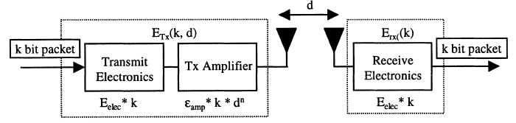

A. Experiment Setup
We assume a simple model for the radio hardware energy dissipation
where the transmitter dissipates energy to run the radio electronics and the power amplifier, and the receiver dissipates energy to run the radio electronics, as shown in Fig.
For the experiments described here, both the
  free space (d² power loss) and the multipath fading (d⁴ power loss) channel models were used, depending on the distance between the transmitter and receiver [22].
Power control can be used to invert this loss by appropriately setting the power amplifier
  if the distance is less than a threshold d0, the free space (fs) model is used; otherwise, the multipath (mp) model is used. Thus, to transmit an l-bit message a distance d, the radio expends

Slide 44
A. Experiment Setup
and to receive this message, the radio expends:
The electronics energy, Eelec , depends on factors such as the
  digital coding, modulation, filtering, and spreading of the signal,
  whereas the amplifier energy єfsd², or єmpd⁴, depends on the distance to the receiver and the acceptable bit-error rate.
For the experiments described in this paper, the communication energy parameters are set as:
  Eelec= 50 nJ⁄bit,
  єfs= 10 pJ⁄bit⁄m² , and
  єmp= 0.0013 pJ⁄bit⁄m⁴ .
  Using our previous experimental results [26], the energy for data aggregation is set as EDA=5 nJ ⁄bit⁄signal.

Slide 45

B. Optimum Number of Clusters
In LEACH, the cluster formation algorithm was created to ensure that the
  expected number of clusters per round is k, a system parameter.
We can analytically determine the optimal value of k in LEACH using the computation and communication energy models.
Assume that there are N nodes distributed uniformly in an M×M region.
If there are k clusters, there are on average N⁄k nodes per cluster (one cluster head and (N⁄k)-1 non-cluster head nodes).
Each cluster head dissipates energy receiving signals from the nodes, aggregating the signals, and transmitting the aggregate signal to the BS.
Since the BS is far from the nodes,
  presumably the energy dissipation follows the multipath model (d⁴ power loss). Therefore, the energy dissipated in the cluster head node during a single frame is
  where I is the number of bits in each data message, dtoBS is the distance from the cluster head node to the BS, and we have assumed perfect data aggregation.

Slide 46
B. Optimum Number of Clusters
Each non-cluster head node only needs to transmit its data to the cluster head once during a frame.
Presumably the distance to the cluster head is small,
  so the energy dissipation follows the Friss free-space model (d² power loss). Thus, the energy used in each non-cluster head node is
  where dtoCH is the distance from the node to the cluster head.

Slide 47
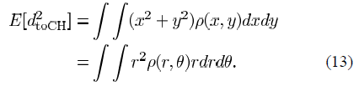
B. Optimum Number of Clusters
The area occupied by each cluster is M²⁄k approximately .
  an arbitrary-shaped region with a node distribution ρ(x,y).
  The expected squared distance from the nodes to the cluster head (assumed to be at the center of mass of the cluster) is given by

