Slide 1
AMCTD: Adaptive Mobility of Courier nodes in
Threshold-optimized DBR Protocol for Underwater
Wireless Sensor Networks
Mohsin Raza Jafri
Department of Electrical Engineering
COMSATS Institute of Information Technology
Islamabad, Pakistan
mohsin09@live.com

Slide 2
Outline
Motivation and Contribution
Proposed Scheme: Adaptive Mobility of Courier Nodes in Threshold-optimized Depth-based Routing (AMCTD)
Performance Evaluation and Analysis
Conclusion and Future Work

Slide 3
Motivation and Contribution
Low stability period in DBR and EEDBR due to unnecessary data forwarding and much load on low-depth node
Disorganized instability period in depth-based routing due to the quick energy consumption of medium-depth nodes

Slide 4
Motivation and Contribution
High availability of threshold-based neighbors by the adaptive changes in depth threshold
Minimization of end-to-end delay and energy consumption of low-depth nodes by the proficient movement of courier nodes
Longer stability period achieved by optimal weight computation techniques

Slide 5
Proposed Scheme: AMCTD
Computation of weights in network initialization
Selection of optimal forwarders are decided on the basis of prioritization of weights
Weight updating and depth threshold adaption on the basis of network density
Adaptive mobility patterns of courier nodes

Slide 6
Network Architecture
Devising of schematic sojourn tour by courier nodes
Setting up depth threshold of sensor nodes to 60m
Calculation of weights using below mentioned formula
Wi = (priority value x Ri) / (Depth of network − Di)
where Ri is the residual energy of node i, Di is the depth of node i and priority value is a constant
Multiple-sink model

Slide 7
Initialization Phase
Sharing of depth information among sensors
Starting of sojourn movements of courier nodes towards surface
Gathering of nodes information by sinks

Slide 8
Network Adaption Specifications and Data forwarding
Selection of optimal forwarder on the basis of weight functions
Broadcasting of node density by the sink
Receiver-based forwarding
Flooding-based approach

Slide 9
Weight Updating Phase
Revisions in weight calculation with change in node density
After the number of dead node increases by 2 %, each node calculates its weight by the following formula
Wi = (priority value x Di) / Ri
Use of alteration to prioritize depth factor

Slide 10
Variation in Depth Threshold and Movement scheme of
Courier nodes
Low movement of first and third courier node in sparse conditions
High movement of second and fourth courier nodes in sparse conditions
As the number of dead nodes increases by 2 %, the depth threshold is decreased to 40m.

Slide 11
Variation in Depth Threshold and Movement scheme of
Courier nodes
Efficient forwarding of data in low network density
Changing of depth threshold to 20m in extreme sparse conditions
Modification in weight calculation in extreme sparse conditions
Wi = Ri / (priority value x Di)

Slide 12
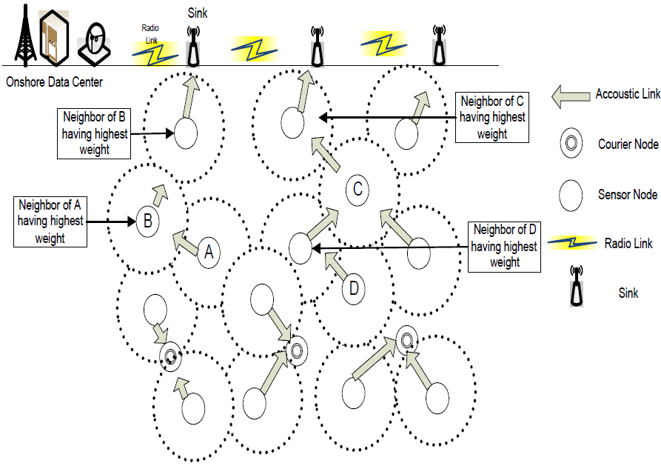
Fig. 1. Mechanism of Data Transmission in AMCTD

Slide 13
Performance Evaluation and Analysis
Parameter | Value
Number of Nodes | 225
Network size | 500m x 500mx500m
Initial energy of normal nodes | 70 J
Data aggregation factor | 0.6
Packet size | 50 bytes
Transmission Range | 100 meters
Number of Courier nodes | 4
Number of Simulations | 3

Slide 14
Performance Metrics
Network Lifetime: It is the time duration between network initialization and complete energy exhaustion of all the nodes.
Average Energy Consumption: It is the energy consumption of all the active nodes in 1 round.
Probability of Dropped packets: It shows the probability
of loss of packets in 1 round.
Number of Dead nodes: It shows the number of dead nodes of the network.
Confidence interval: It is an interval in which a measurement or trial falls corresponding to a given probability.

Slide 15
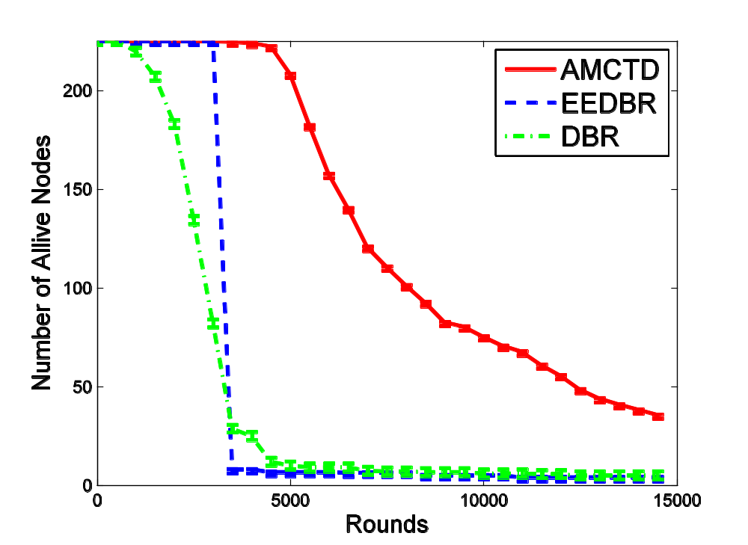
Network Lifetime Graph
In the simulation of 15000 rounds, nodes have been deployed randomly in every simulated technique.
Figure 2 represents the comparison between
the network lifetime of AMCTD, EEDBR and DBR.
Fig. 2

Slide 16
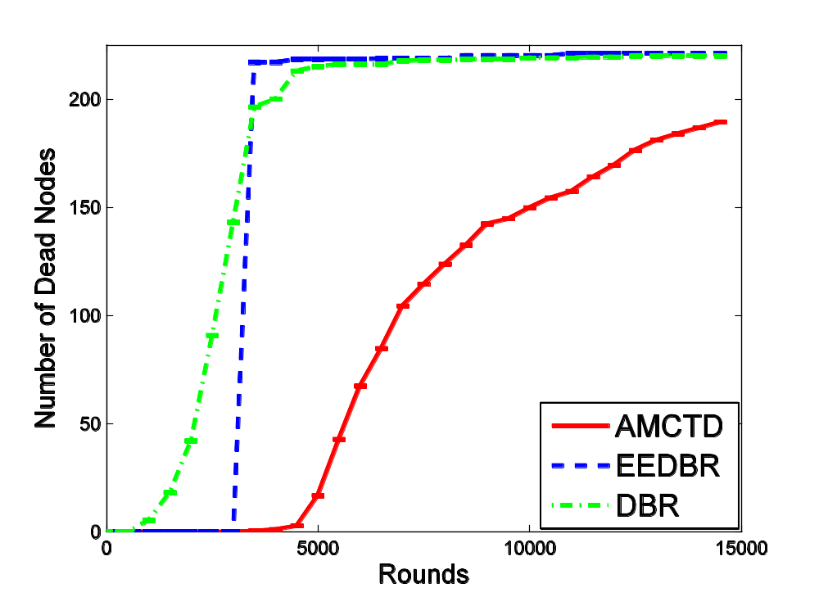
Comparison of Dead nodes in AMCTD, EEDBR and DBR
Evaluation of dead nodes variation in AMCTD, EEDBR and DBR along with the average results of 3 simulation runs
Improvement in stability period due to implementation of adaptive mobility of courier nodes and removal of redundant data forwarding
Capable instability period due to changes in depth threshold and optimal forwarder assortment in later rounds
Fig. 3

Slide 17
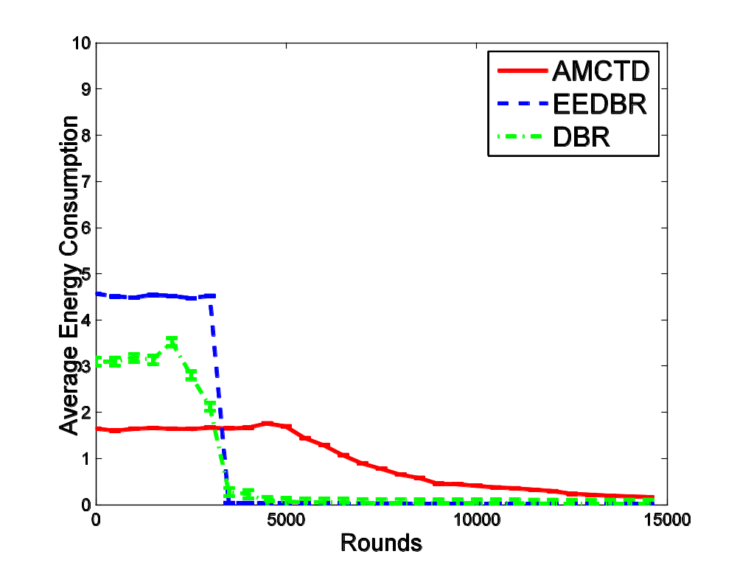
Confidence Intervals of Total energy consumption in AMCTD,
EEDBR and DBR
Comparison between the average energy consumption of network
Proficient energy utilization due to effective weight implementation
Equal energy utilization along the entire lifetime minimizes the coverage holes creation.
Fig. 4

Slide 18

Comparison of Network Throughput in AMCTD, EEDBR and DBR
Estimation of throughput of network during the network lifetime
Enhancement of throughput due to presence of courier nodes and the changes in depth threshold
Stable network performance at the later rounds along with the constant end-to-end delay for packets
Fig. 5

Slide 19
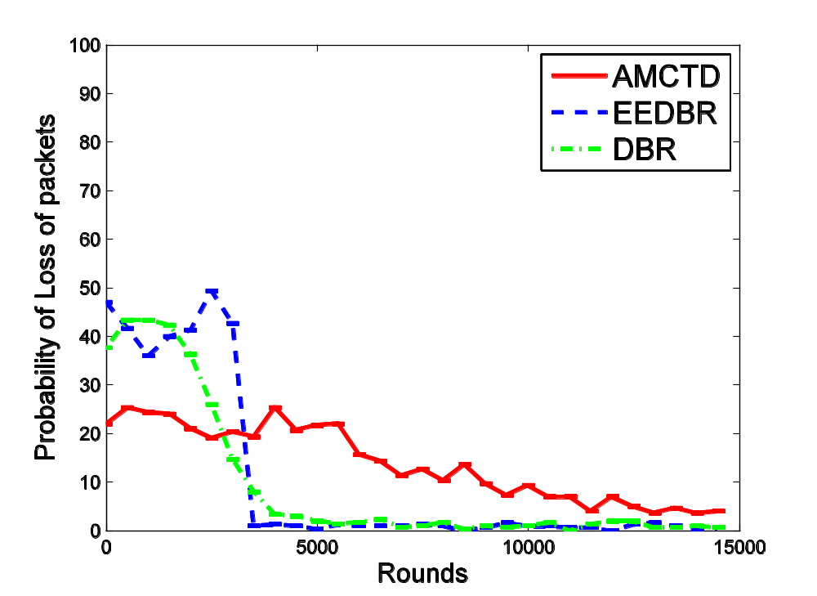
Confidence Intervals of Probability of loss of packets in AMCTD,
EEDBR and DBR
Illustration of the confidence intervals of probability of lost packets
Illustration of optimal link judgment in our proposed techniques even in the later rounds
Fig. 6

Slide 20
Conclusion
In this paper, we recommend an Adaptive Mobility of Courier nodes in Threshold-optimized Depth-based routing protocol to maximize the network lifetime of UWSN.
Amendments in depth threshold enlarge the number of threshold-based neighbors in the later rounds, hence enhancing the instability period.
Optimal weight computation not only provides the global load balancing in the network, but also gives proficient holding-time calculation for the neighbors of source nodes.
The adaptive movement of courier nodes upholds the network throughput in the sparse condition of network.

Slide 21
Future Work
Designing much better courier nodes mobility pattern specifically toward the source nodes
Plans to integrate asynchronous MAC protocols with our routing scheme

Slide 22
Questions
Thank you!

